Slide 1
GAGGIA MDF 55
NEW PREMIUM GRINDER

Slide 2
1.1 ART & DESIGN
1. MDF55
FUNDAMENTALS
The new Gaggia MDF 55 premium grinder is made:
TO OFFER A TRULY BARISTA EXPERIENCE AT HOME
WITH A MADE IN ITALY COMPANY, EXPERT IN THE PROFESSIONAL COFFEE GRINDING FIELD
TO BE THE PERFECT COMPANION FOR GAGGIA CLASSIC, EMBEDDING GAGGIA BRAND VALUES AND DESIGN SIGNATURE ELEMENTS
CONFIDENTIAL

Slide 3
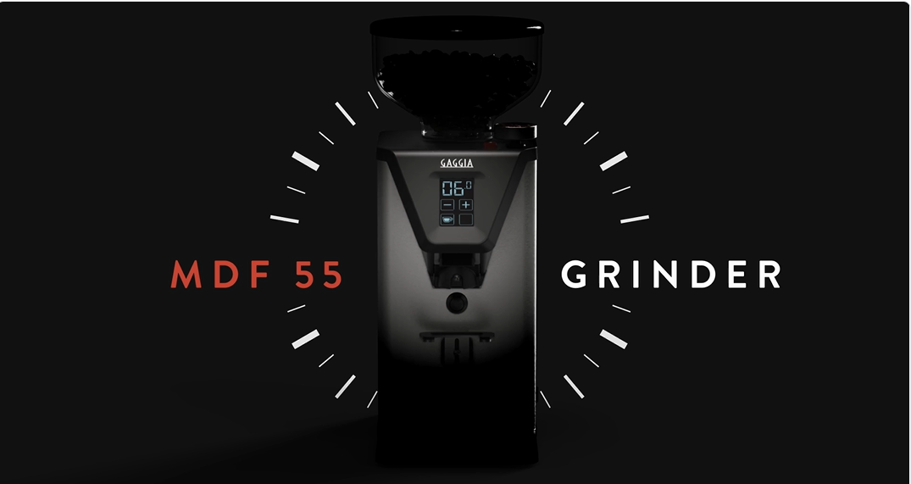

Slide 4
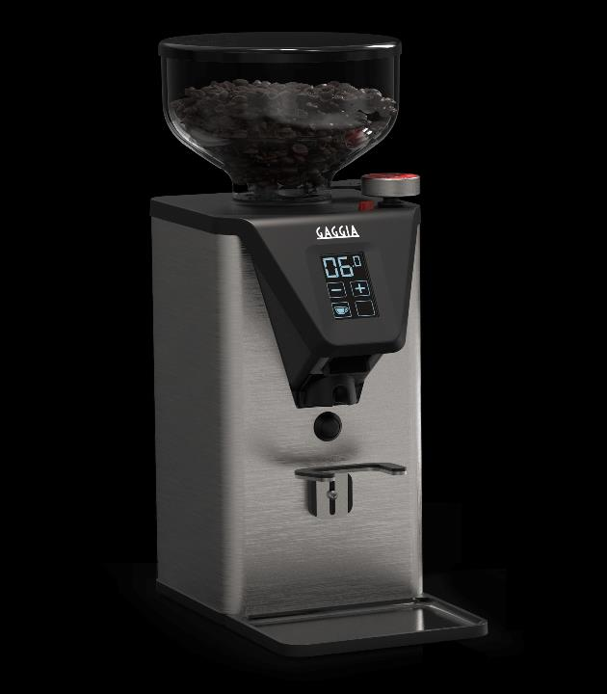
2. PRODUCT KEY VALUES
THE PERFECT COMPANION FOR YOUR HOME BARISTA EXPERIENCE
TRULY ITALIAN DESIGN
100% handcrafted in Italy, it embeds Gaggia’s values and design signature elements
PRO PERFORMANCE
For a true barista experience at home
EMPOWERED USER EXPERIENCE
Easy and full control for the best in-cup results

Slide 5
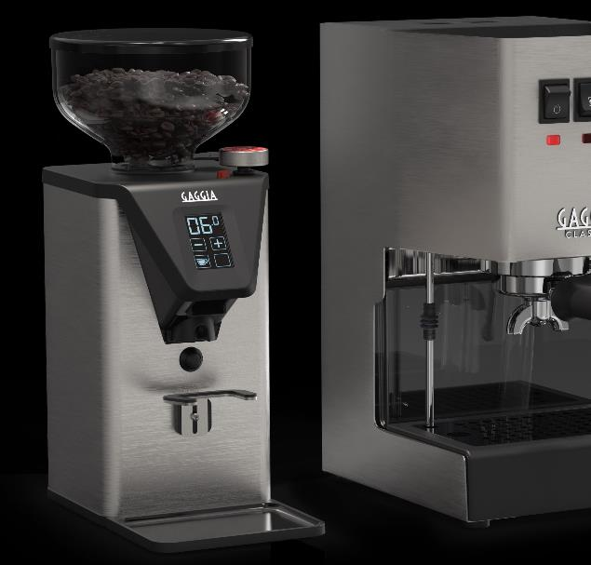
2.1 PRODUCT KEY VALUES
TRULY ITALIAN DESIGN
MADE IN ITALY
100% designed and carefully made in Italy
EXCLUSIVE GAGGIA DESIGN
perfect match and bundle with our espresso manual coffee machines
enriched by exclusive details: the Gaggia red grinding knob label with signature heritage logo, the interface area, the removable coffee mat
PREMIUM AND STURDY MATERIALS
full aluminum body and metal details, stainless-steel rotating knob with enhanced grip, metal filter-holder fork with premium rubber cover

Slide 6
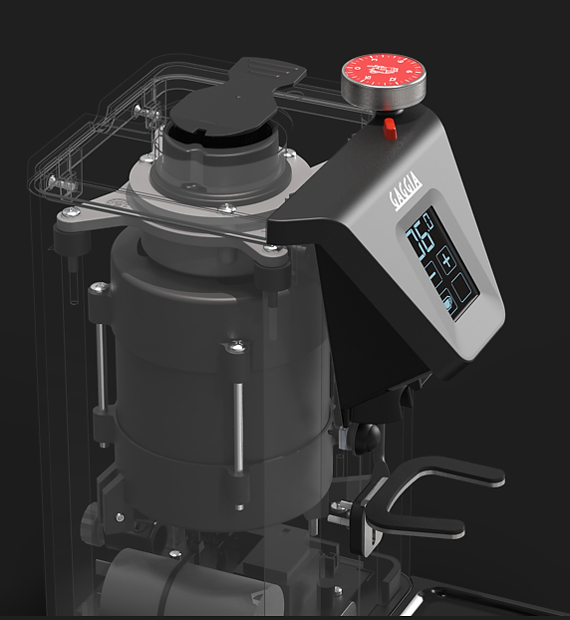
2.2 PRODUCT KEY VALUES
PRO PERFORMANCE
55 MM Ø FLAT HARDENED STEEL BURRS
The wide burrs guarantee a quick and more consistent grinding performance: for any amount of beans, a greater diameter implies fewer rotations of the burr to grind the beans. This also prevents overheating and preserves the quality of coffee.
POWERFUL AND FAST MOTOR
With the 310 W* motor spinning at 1350 RPM, it dispenses 1.8 g/s when set for espresso, and 2.5 g/s when set for brew.
ANTI-CLUMPING SYSTEM
It eliminates electrostatic charge in ground coffee, and it secures higher dose consistency
* 230v

Slide 7
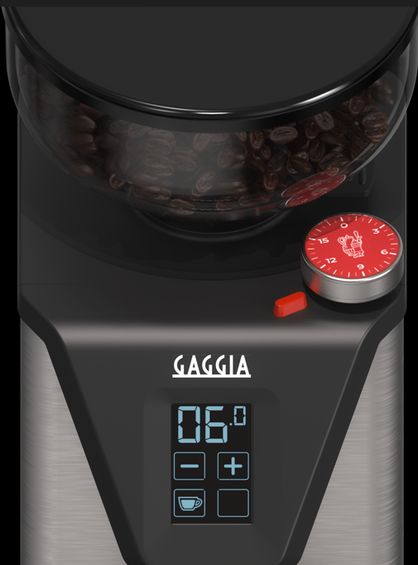
2.2 PRODUCT KEY VALUES
PRO PERFORMANCE
STEPLESS MICROMETRIC ADJUSTMENT
The precise micrometric grind adjustment allows a strict control on the infinite changes on grind size. This makes the grinder adaptable to all coffee blends, and appropriate for all grinds: espresso, Turkish coffee, moka, drip, French press, …
STAINLESS STEEL SENSITIVE KNOB
To easily adjust the grind with precision and full control, with immediate feedback
FACTORY SETTING
The coffee grinder is set by default on a size of grinding suitable for espresso. Turn the adjustment knob to find your preferred types of grinding
LOWER BURR REPOSITIONING
To carry out maintenance operations without losing the grinding setting

Slide 8
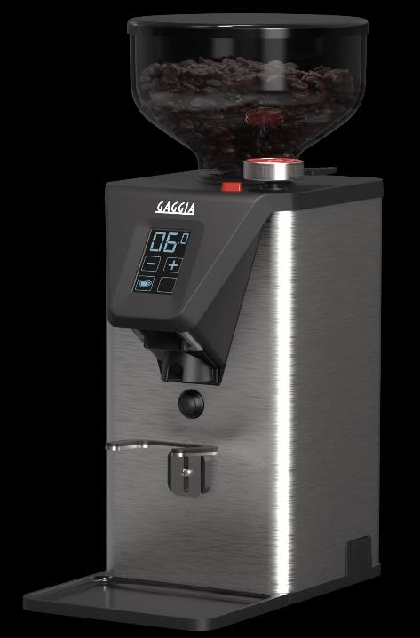
2.3 KEY VALUES
EMPOWERED USER EXPERIENCE
RED INDICATOR
To help in identifying the position of the selected grinding
INTUITIVE TOUCHSCREEN DISPLAY
It makes it easy to select your preferred dose and to adjust grind times, to select the “on demand “ function and to switch from single to double shot
ADJUSTABLE PORTAFILTER HOLDER FORK
for any portafilter on the market, with a premium rubber cover
REDUCED-NOISE EXPERIENCE
Thanks to the anti-vibration technology and to the silent grind (-20dB quieter than conventional grinders)
REMOVABLE COFFEE MAT
to collect coffee residues and keep your coffee station clean

Slide 9
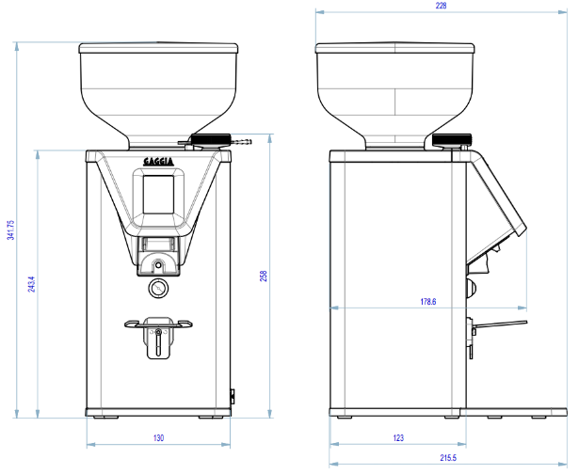
3. TECH FEATURES
SPECIFICATIONS
User Interface | Touch screen
Body Material | Aluminum
Grinder Setting controls | Micrometric Stepless
Burrs material | Hardened steel
Grinder Burr type | Flat
Grinder burr diameter | 55 mm
Dispensing Method | Doserless
Bean hopper capacity | 250g
Removable Bean Hopper | Yes
Programmable Grinding | Timed, single/double shot
On demand grinding | Yes
Dose counter | Yes
Coffee Mat | Yes
Motor Rpm | 1350*
Recommended grind selection | All-purpose
Productivity (g/s) | 1,2 - 1,8 Espresso 1,9 - 2,5 Brew
Dimensions (H, W, D) mm | 340 x 135 x 225
Weight (Kg) | 5,5
* 230v version

Slide 10
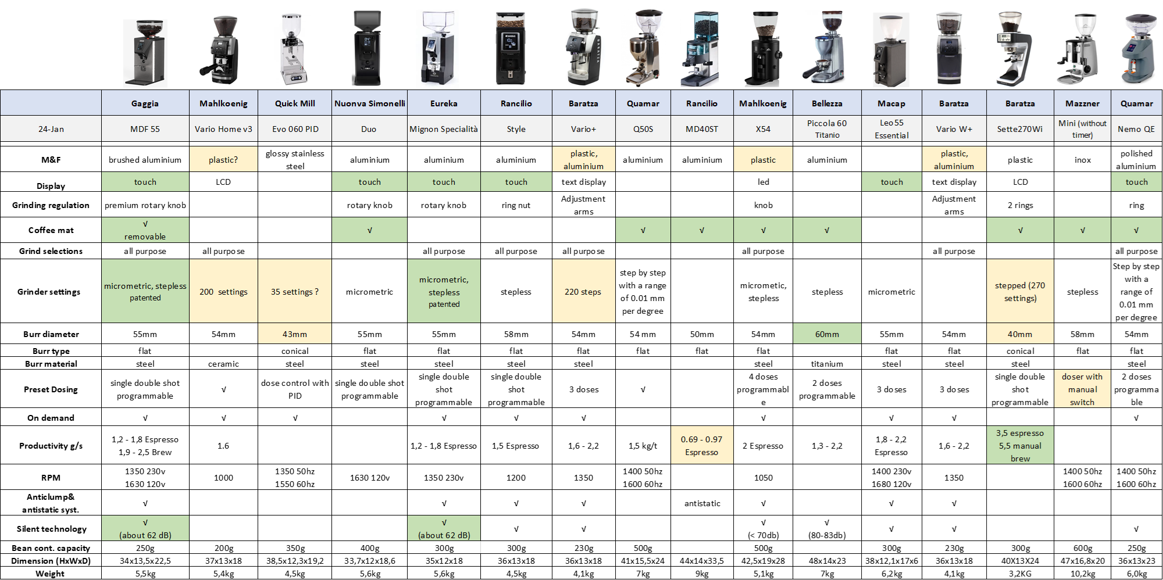
4. BENCHMARK
MDF 55 BENCHMARK
With its exclusive design and Pro performance, the MDF 55 has the right to upgrade every coffee station

Slide 11
5. PRODUCT
MDF 55 AVAILABILITY
THE NEW MDF 55 WILL BE AVAILABLE IN 4 DIFFERENT COUNTRY VERSIONS
120V → EG4950/90 US GAG. PREMIUM GRINDER ALU
230V schuko plug → EG4950/90 EU GAG. PREMIUM GRINDER ALU
230V UK plug → EG4950/90 UK GAG. PREMIUM GRINDER ALU
220V Australia → EG4950/90 AUS GAG. PREMIUM GRINDER ALU
DELIVERIES START FROM THE END OF MARCH 2024
FOR OTHER COUNTRY VERSIONS
timing is based on certification and business opportunities. Get in touch with Andrea Nebuloni and his team to discuss about it.

Slide 12
